Slide 1
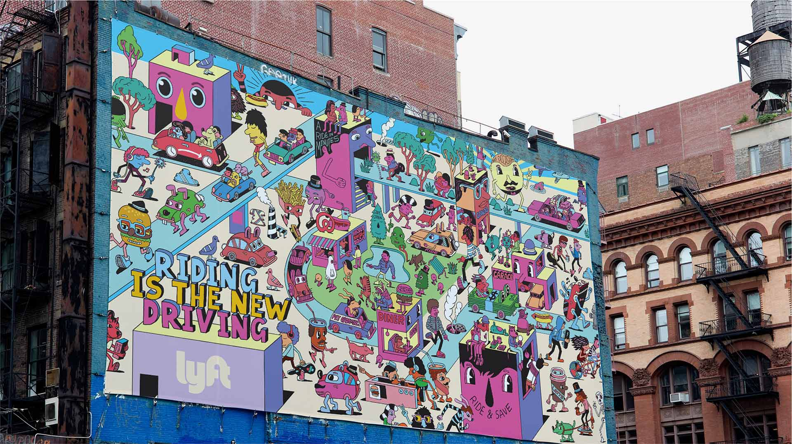

SQL Project
Group:- Lyft It
Thao Nguyen(W1630222), Surbhi Zambad(W1628802), Anjali Gupta(W1628563),
Amey Darwhekar(W 1609959), Shilpi Kumari(W1628645)

Slide 2

Agenda
Business case scenario
Swim lane diagram
ER diagram
Table creation
SQL Queries
Stored procedures and triggers
Views
Lessons learned

Slide 3
Business Case Scenario:- Booking a lyft
It is Saturday night after a long week of exams. Everyone is going out to celebrate the end of it. Shilpi has made plan to go bowling with her friends too. 7:30 pm, she login into her Lyft app to book a ride from Littleton street to the bowling alley on Alameda street. She enters the pick-up and drop-off locations. Payment detail is already saved on the app for her account. The app shows many ride options with their respective pickup time and price. Shilpi chooses the standard sedan option and money is automatically deducts from the card she saved on the app. 2 minutes later, she receives a text on her phone that a driver named Tom is on the way to pick her up in sedan 6TRJ244. Lyft app allows her to see the driver’s picture, contact number, rating, and his real time location. At 7:40 pm, she receives another text saying her previous ride was cancelled and her money will be refunded into the account within 24 hours. She books another ride in the same process. The new driver arrives at 7:45 pm. Shilpi gets in and she can track the ride from the app. When the car is near Alameda, she receives a notification telling her that her destination is coming up. Few minutes later, the driver drops her off and Shilpi gets notified by the app that ride is completed. Finally, Shilpi rates the driver and the ride.

Slide 4
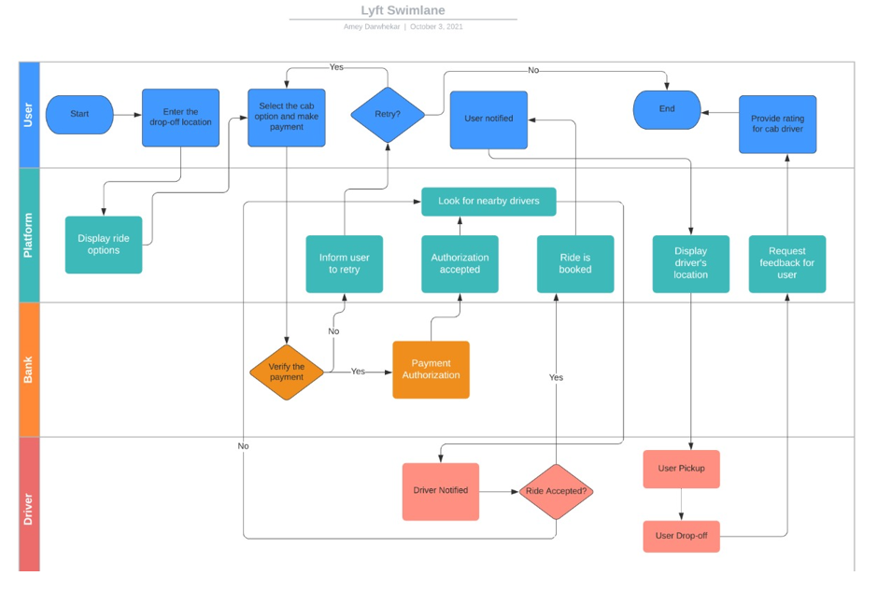
Swim Lane Diagram

Slide 5
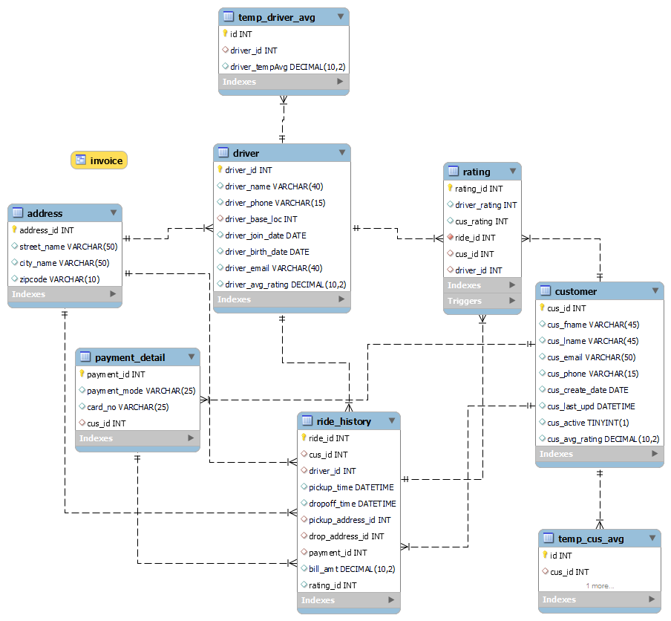
Entity-Relationship Diagram

Slide 6
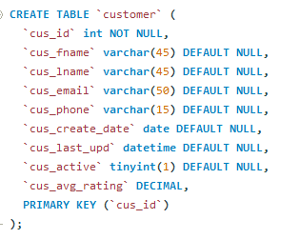
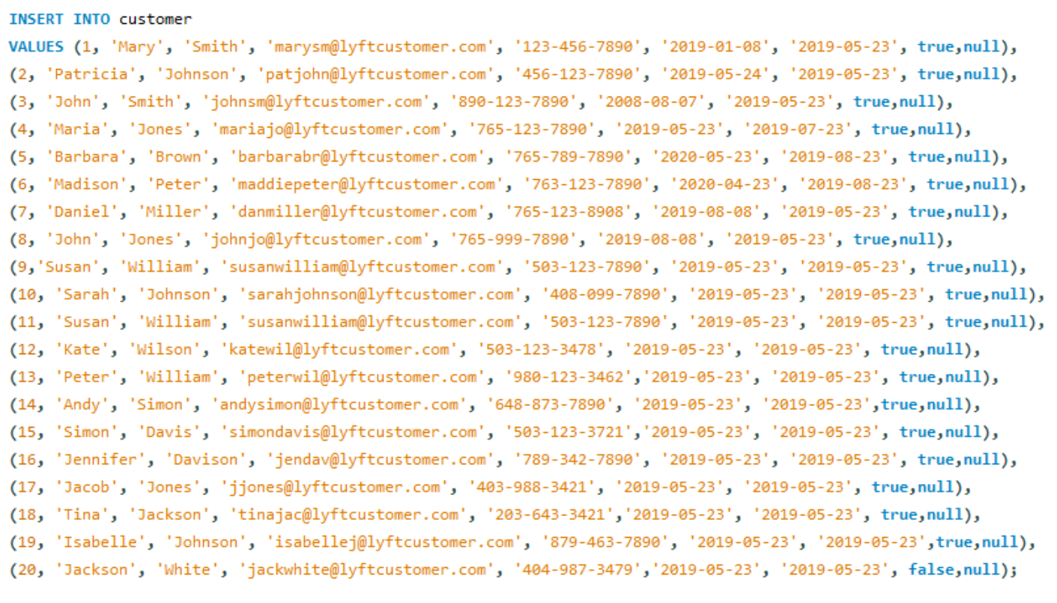
Table Creation – Customer Table

Slide 7
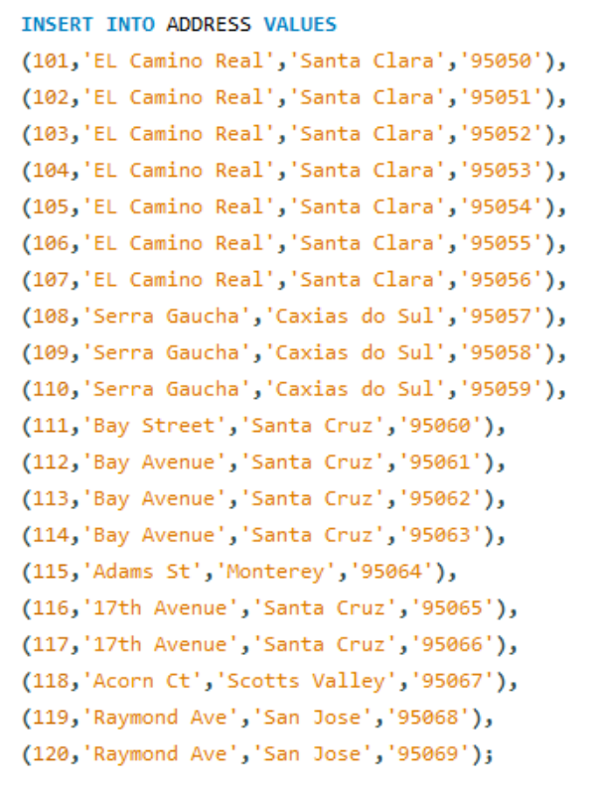
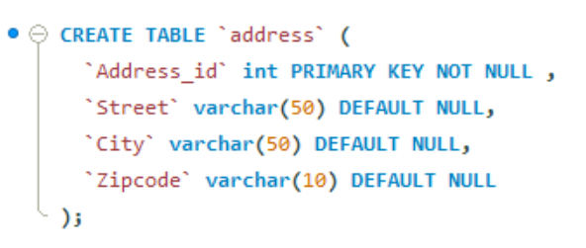
Table Creation – Address Table

Slide 8
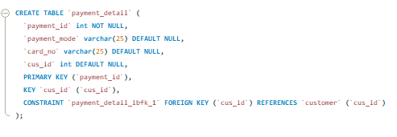
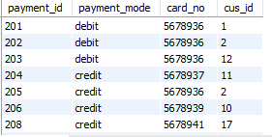
Table Creation – Payment Detail Table

Slide 9
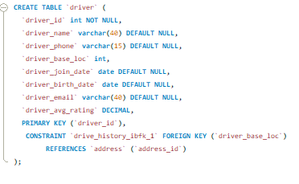
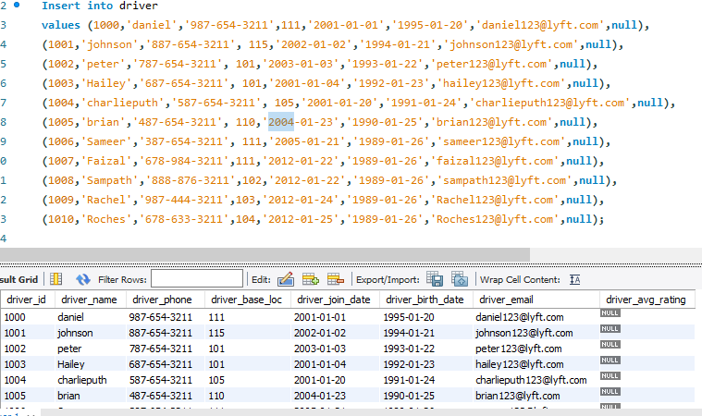
Table Creation – Driver Table

Slide 10
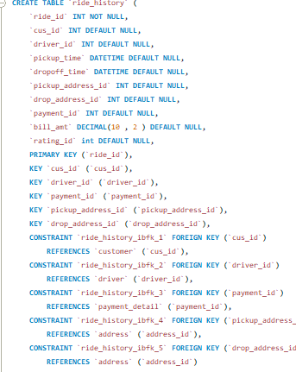
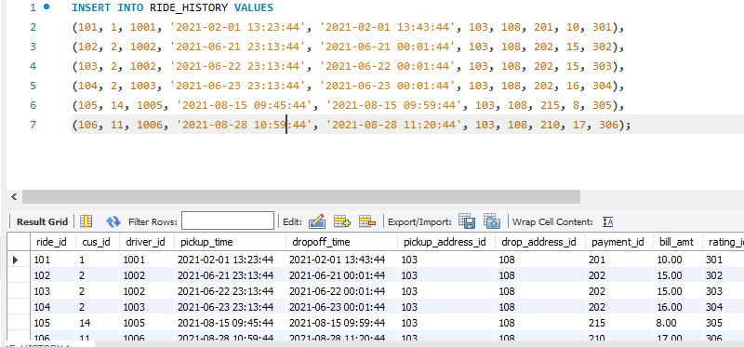
Table Creation – Ride History Table

Slide 11
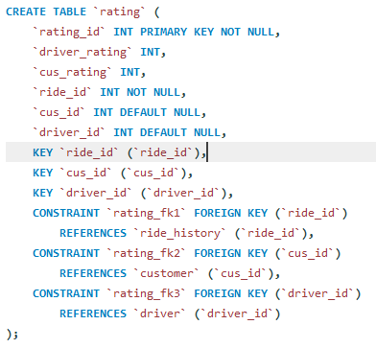
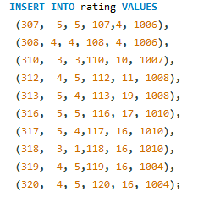
Table Creation – Rating Table

Slide 12


SQL Query

Slide 13
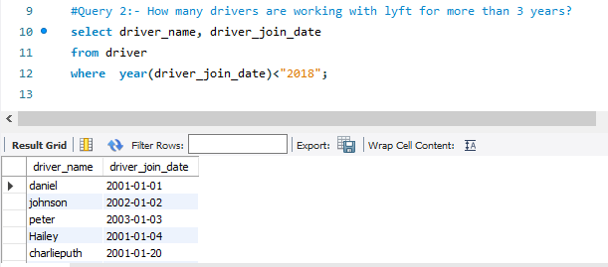
SQL Query

Slide 14
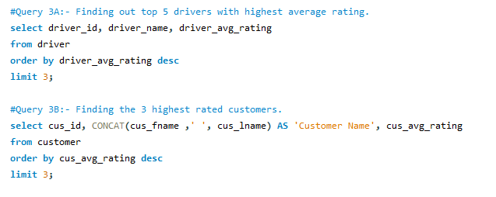
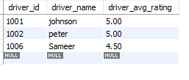
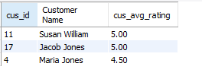
SQL Query

Slide 15
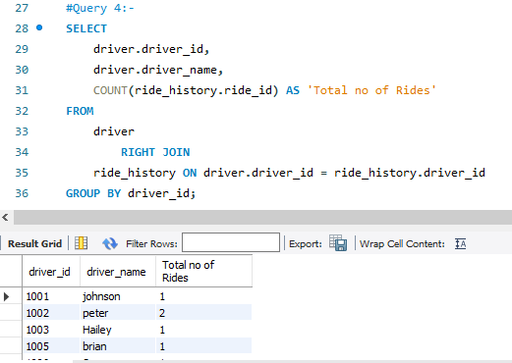
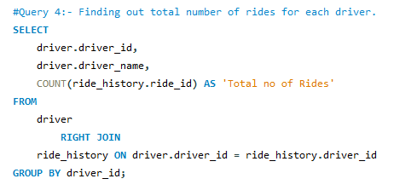
SQL Query

Slide 16
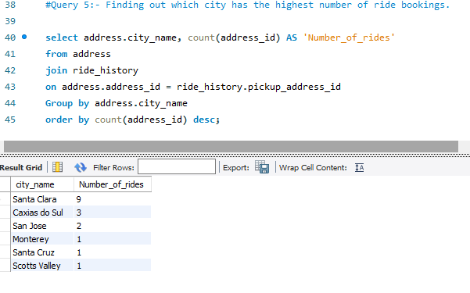
SQL Query

Slide 17
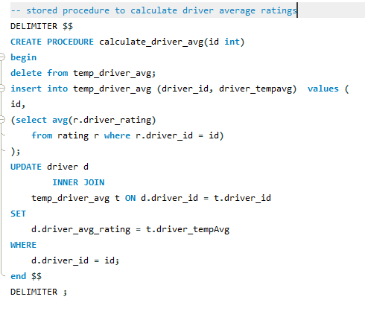
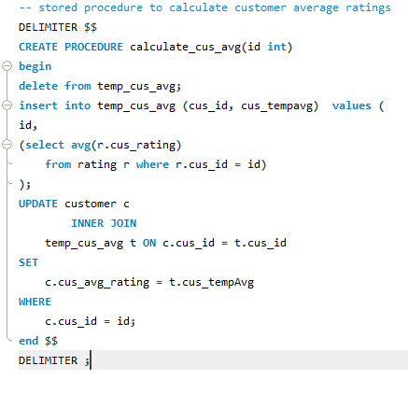
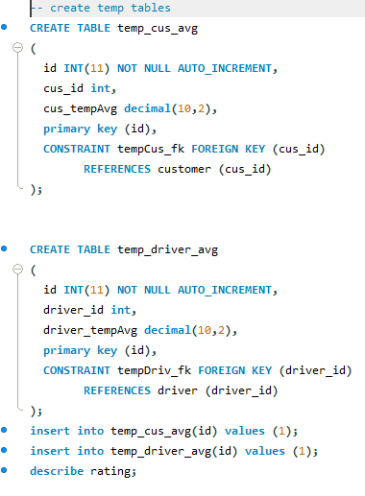
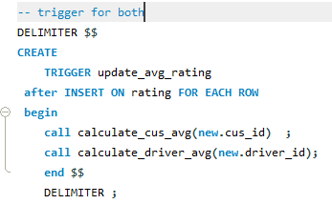
Calculating average ratings

Slide 18
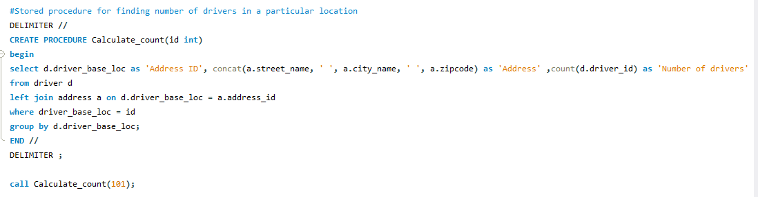
SQL Stored Procedure

Slide 19
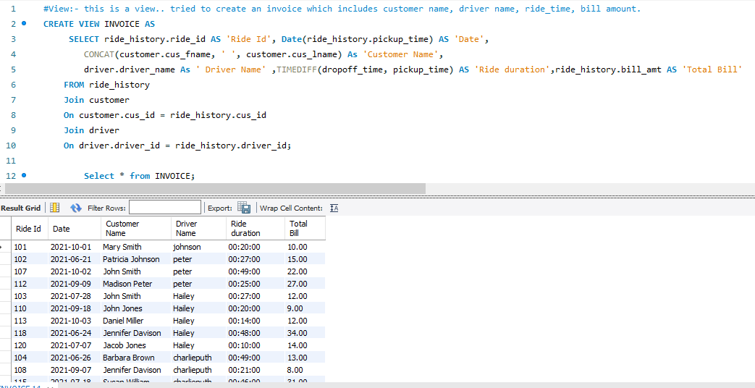
SQL Views

Slide 20
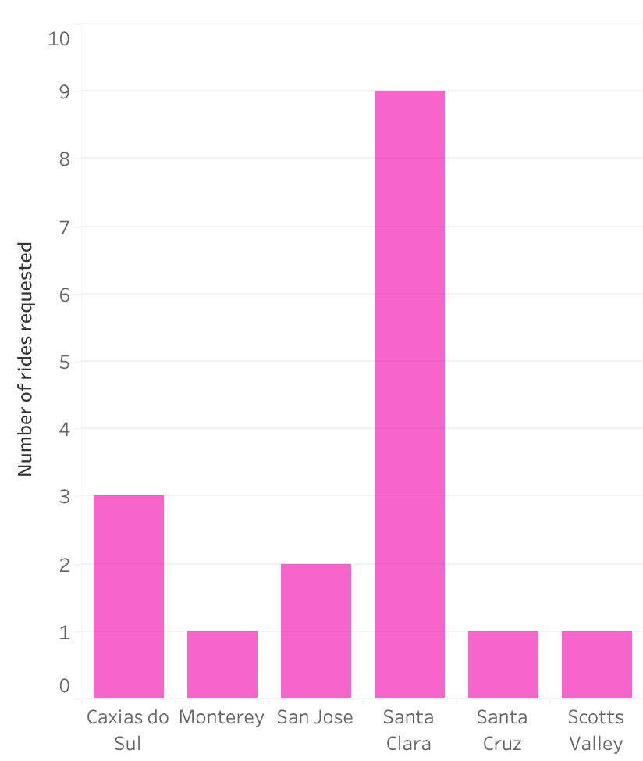
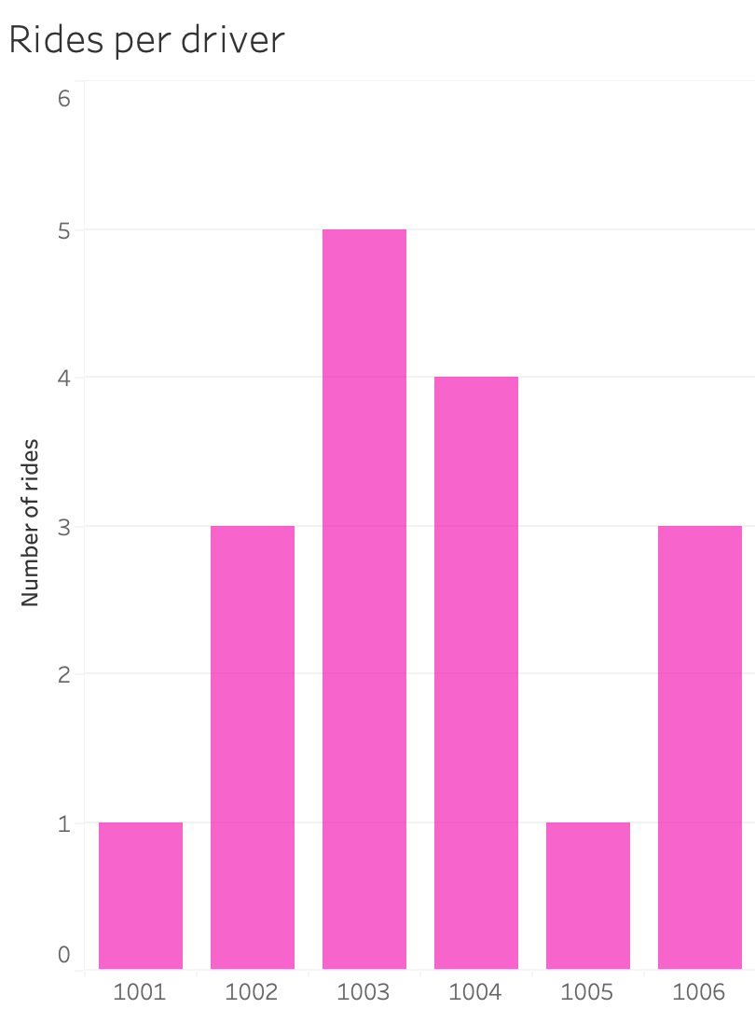
Visualization-Rides
City wise ride distribution

Slide 21
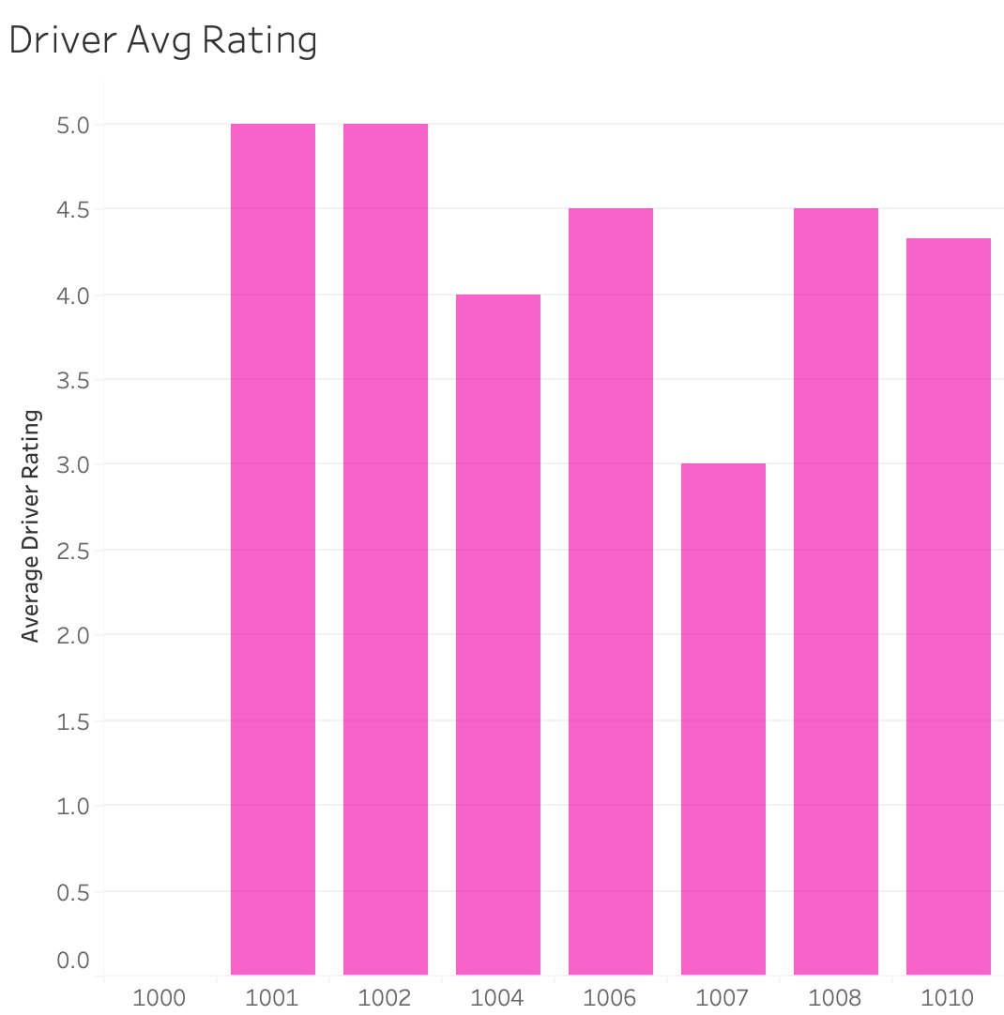
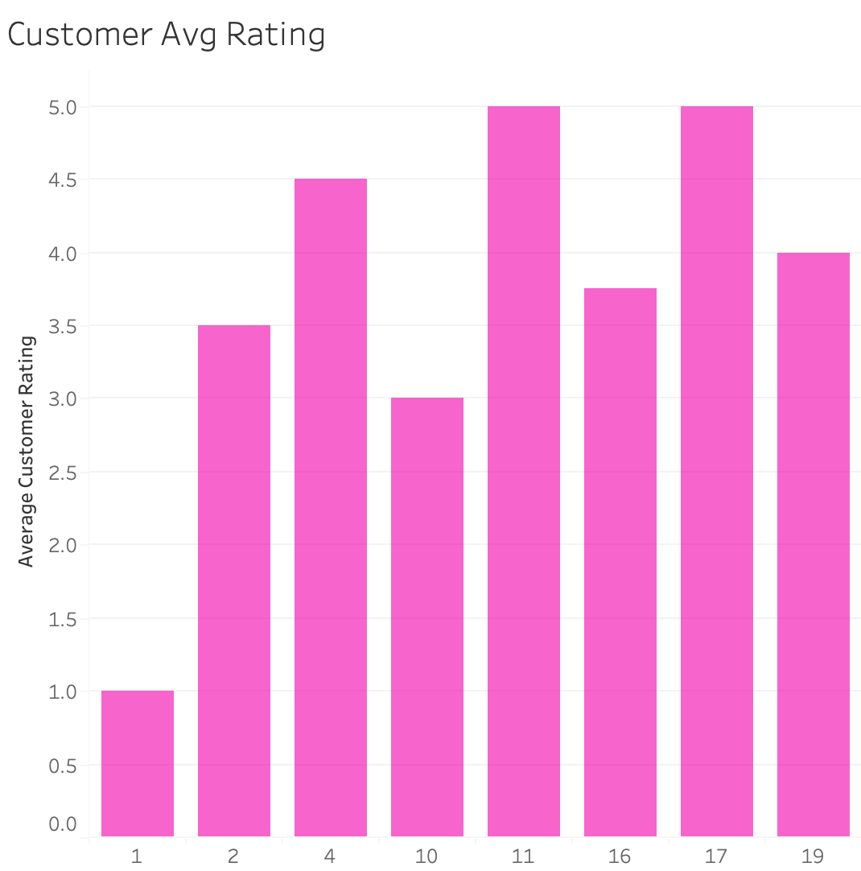
Visualization

Slide 22
Lessons learned and conclusion

Slide 23

Thank You

